Slide 1

LETOURNEAU UNIVERSITY EETC 3433 ELECTRICAL MACHINERY AND CONTROLS for JLNU Fall Semester 2024
By Judy WS Wong

Slide 2

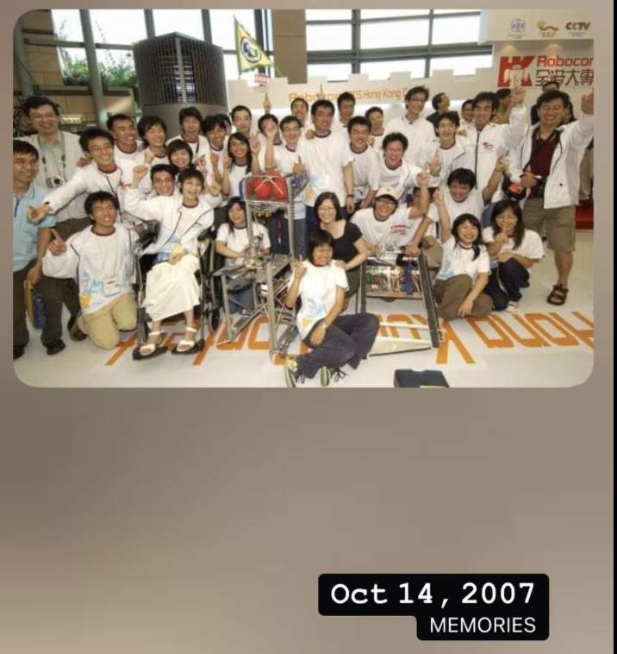
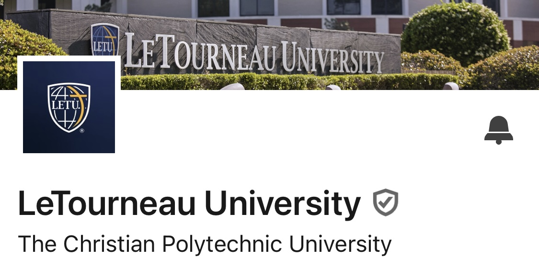
Judy Wong
HKUST Robocon 2004-07
Robi3 Robotics
Agile Coach
I understand Chinese, but as a rule I’ll only use English during class – you can however use terms in Chinese in case you need to express yourself

Slide 3
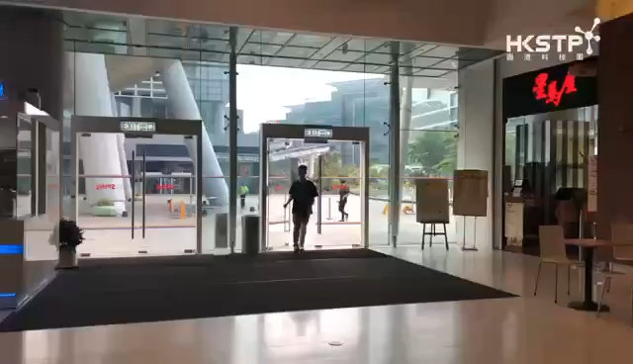
Ice-cream Robot (2019)

Slide 4

鸡蛋仔 Egg Waffle Machine(2020)
I understand Chinese, but as a rule I’ll only use English during class – you can however use terms in Chinese in case you need to express yourself

Slide 5
Purpose
Targeted learning
to be able to apply knowledge learn in this course in future
Personalied learning (因材施教)
course will be adjusted according to the students’ progress
Cultural Exposure
Understanding what tools are used internationally

Slide 6
Grading
Homework / classwork
Quiz /presentation
Laboratory Exercises /project
Comprehensive Final Exam (Open Book)
40%
20%
20%
20%
Attendance - at least 60% to pass

Slide 7
Teachers may not be right
Teachers / parents / seniors aren’t always right - we are more experienced and share our knowledge and experiences to coach you with, but often we learn new things together

Slide 8
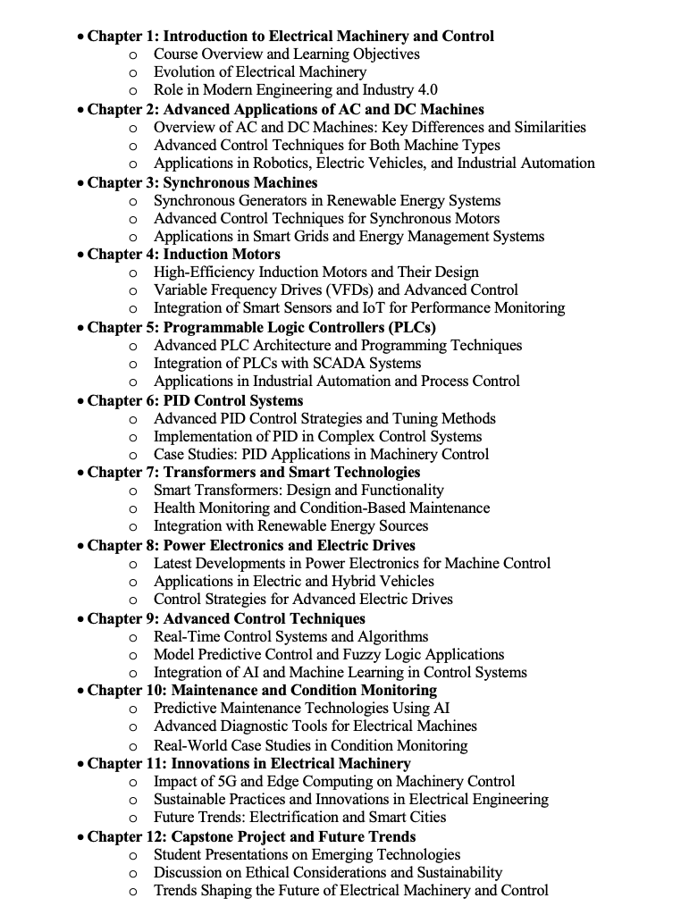
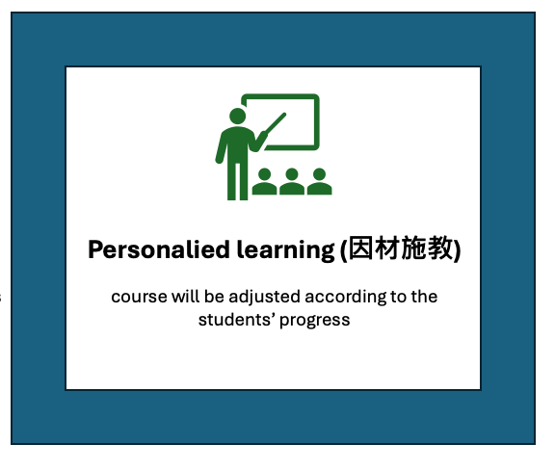
Syllabus
designed

Slide 9

Cultural Exposure
Kahoot! / Mentimeter
Github
Group discussion

Slide 10


Let me get to know you guys

Slide 11
GitHub Classroom
https://github.com
https://classroom.github.com/classrooms/186245921-jlnu-eetc3433-fall2024

Slide 12
Teachers may not be right
Teachers / parents / seniors aren’t always right - we are more experienced and share our knowledge and experiences to coach you with, but often we learn new things together

Slide 13
Group discussion after lesson
an example machine you would consider needed for motion control
Will have discussion after the lesson
~6-8 people in a group
I’ll randomly pick group to share this – just show a picture on screen here would be fine

Slide 14
Chapter 1: Introduction to Control Systems
Objectives
In this chapter we describe a general process for designing a control system.
A control system consisting of interconnected components is designed to achieve a desired purpose. To understand the purpose of a control system, it is useful to examine examples of control systems through the course of history. These early systems incorporated many of the same ideas of feedback that are in use today.
Modern control engineering practice includes the use of control design strategies for improving manufacturing processes, the efficiency of energy use, advanced automobile control, including rapid transit, among others.
We also discuss the notion of a design gap. The gap exists between the complex physical system under investigation and the model used in the control system synthesis.
The iterative nature of design allows us to handle the design gap effectively while accomplishing necessary tradeoffs in complexity, performance, and cost in order to meet the design specifications.

Slide 15
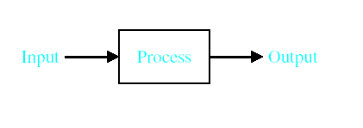
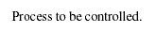
Introduction
System – An interconnection of elements and devices for a desired purpose.
Control System – An interconnection of components forming a system configuration that will provide a desired response.
Process – The device, plant, or system under control. The input and output relationship represents the cause-and-effect relationship of the process.

Slide 16
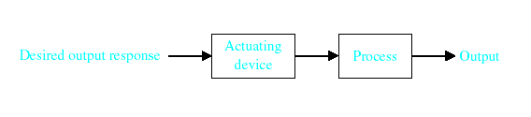
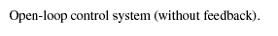
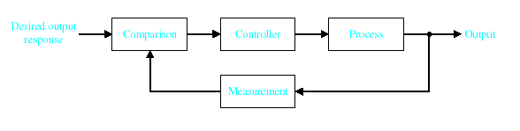
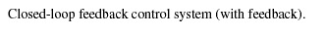
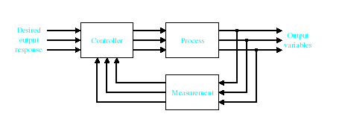
Introduction
Open-Loop Control Systems utilize a controller or control actuator to obtain the desired response.
Closed-Loop Control Systems utilizes feedback to compare the actual output to the desired output response.
Multivariable Control System

Slide 17
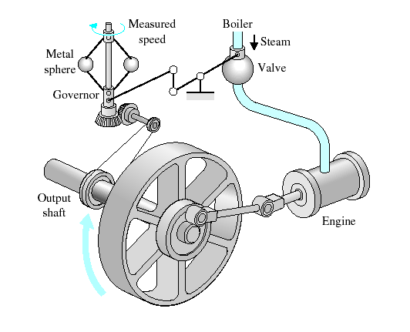
History
Greece (BC) – Float regulator mechanism
Holland (16th Century)– Temperature regulator
Watt’s Flyball Governor
(18th century)

Slide 18
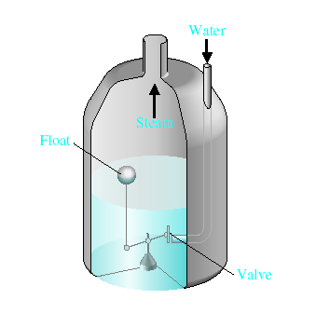
History
Water-level float regulator

Slide 19
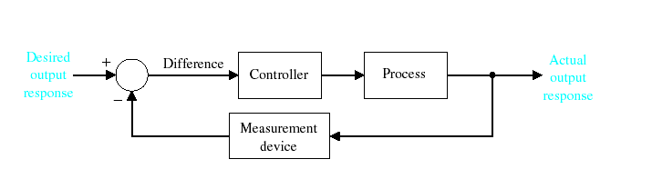
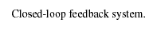
History

Slide 20
History
18th Century James Watt’s centrifugal governor for the speed control of a steam engine.
1920s Minorsky worked on automatic controllers for steering ships.
1930s Nyquist developed a method for analyzing the stability of controlled systems
1940s Frequency response methods made it possible to design linear closed-loop control systems
1950s Root-locus method due to Evans was fully developed
1960s State space methods, optimal control, adaptive control and
1980s Learning controls are begun to investigated and developed.
Present and on-going research fields. Recent application of modern control theory includes such non-engineering systems such as biological, biomedical, economic and socio-economic systems

Slide 21
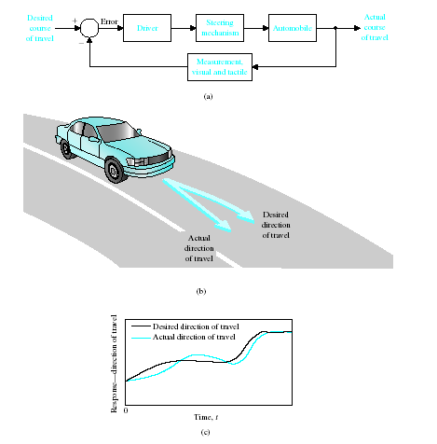
Examples of Modern Control Systems
(a) Automobile steering control system.
(b) The driver uses the difference between the actual and the desired direction of travel
to generate a controlled adjustment of the steering wheel.
(c) Typical direction-of-travel response.

Slide 22
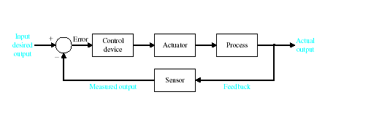
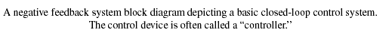
Examples of Modern Control Systems

Slide 23
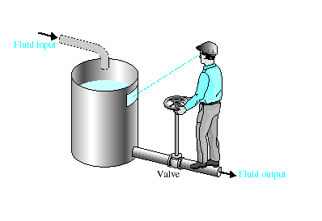
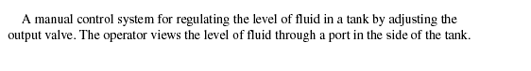
Examples of Modern Control Systems

Slide 24
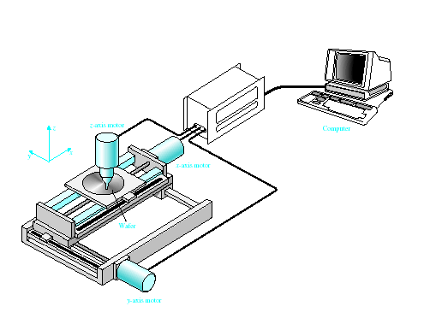
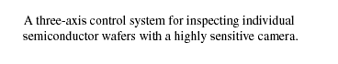
Examples of Modern Control Systems

Slide 25
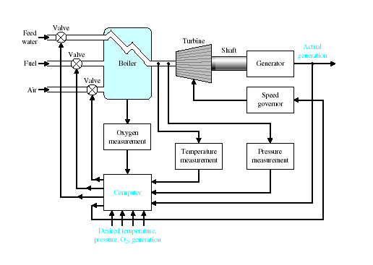
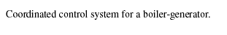
Examples of Modern Control Systems

Slide 26
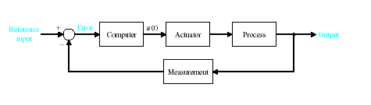
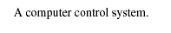
Examples of Modern Control Systems

Slide 27
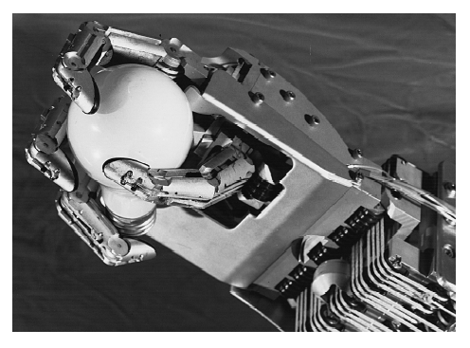
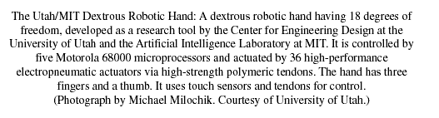
Examples of Modern Control Systems

Slide 28
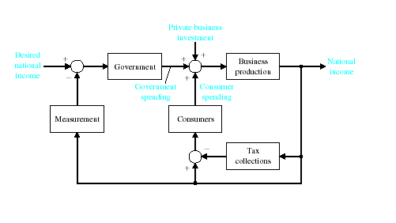
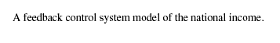
Examples of Modern Control Systems

Slide 29
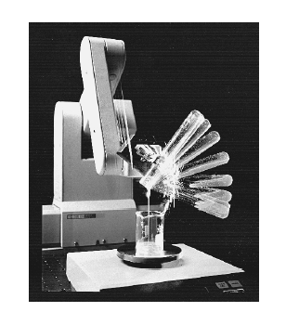
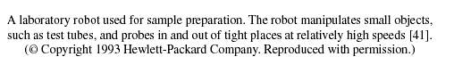
Examples of Modern Control Systems

Slide 30
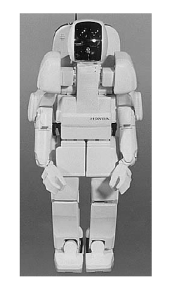
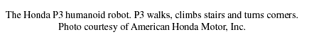
The Future of Control Systems

Slide 31
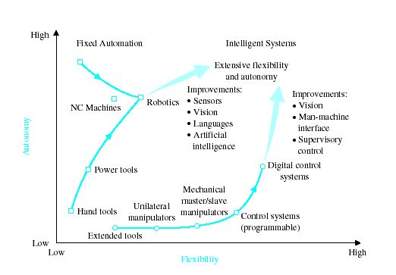
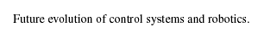
The Future of Control Systems

Slide 32
Group discussion (10 min break/ preparation)
an example machine you would consider needed for motion control
~6-8 people in a group
I’ll randomly pick group to share this – just show a picture on screen here would be fine

Slide 33
Group discussion after lesson
What kind of motion control would you like to learn in this course – identify machine control parts here
Will have discussion after the lesson
~6-8 people in a group
I’ll randomly pick group to share this – just show a picture on screen here would be fine

Slide 34
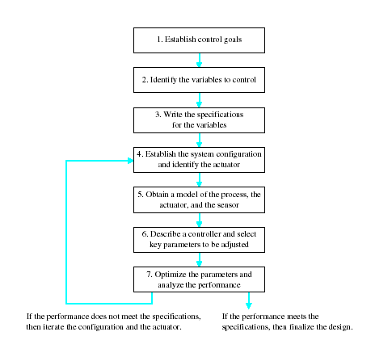
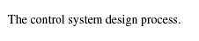
Control System Design

Slide 35
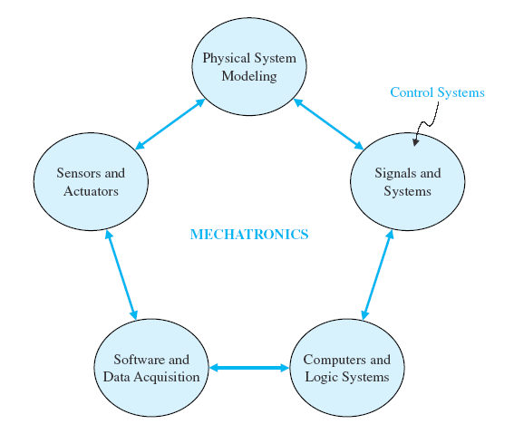

Slide 36
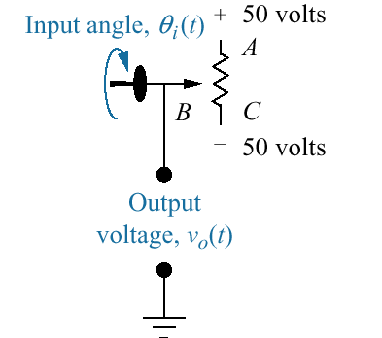
Design Example

Slide 37
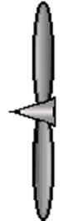
Design Example
ELECTRIC SHIP CONCEPT
Vision
Electrically
Reconfigurable
Ship
All
Electric
Ship
Integrated
Power
System
Technology
Insertion
Warfighting Capabilities
Increasing Affordability and Military Capability
Electric Drive
Reduce # of Prime Movers
Fuel savings
Reduced maintenance
Reduced manning
Automation
Eliminate auxiliary systems (steam, hydraulics, compressed air)
Propulsion
Motor
Main Power
Distribution
Motor
Drive
Generator
Prime
Mover
Power
Conversion
Module
Ship
Service
Power

Slide 38
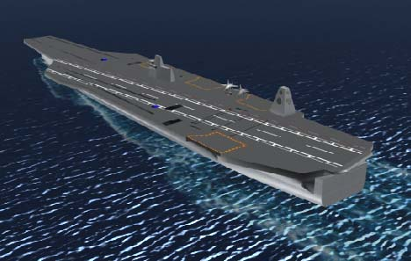
Design Example
CVN(X) FUTURE AIRCRAFT CARRIER

Slide 39
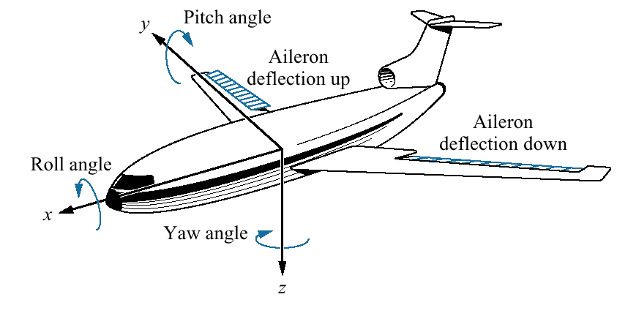
Design Example

Slide 40
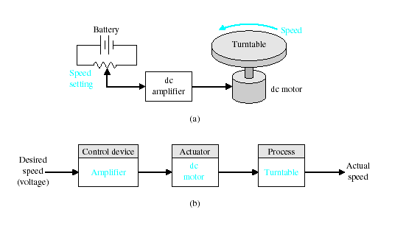
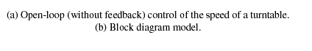
Design Example

Slide 41
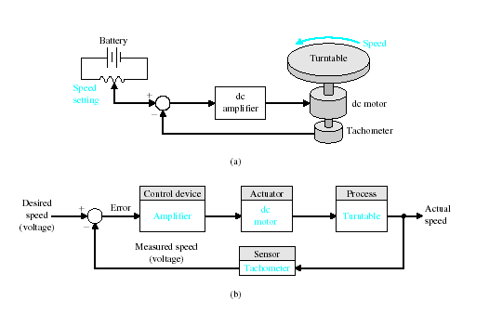
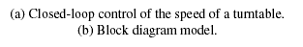
Design Example

Slide 42
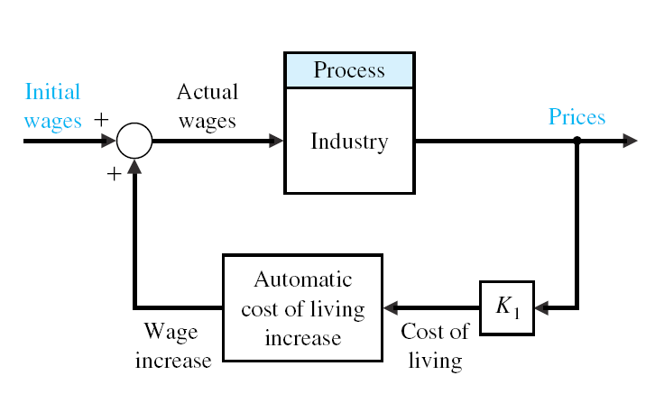

Slide 43
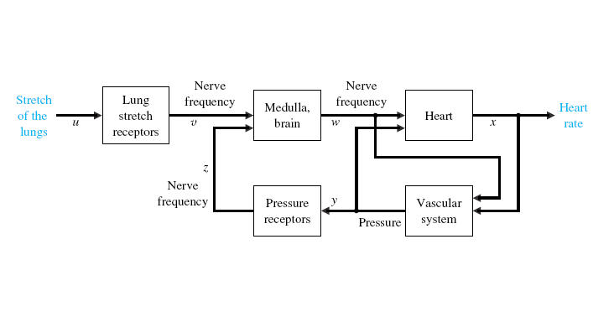

Slide 44


Design Example

Slide 45


Design Example

Slide 46


Sequential Design Example

Slide 47


Slide 48


Sequential Design Example

Slide 49
Group discussion – class expectation
Discuss: What are you expecting in this control class - able to control an airplane? able to control a car? robot?
~6-8 people in a group
I’ll randomly pick group to share this – just show a picture on screen here would be fine

Slide 50
Keep in touch - GitHub Classroom
https://github.com
https://classroom.github.com/classrooms/186245921-jlnu-eetc3433-fall2024

